Slide 1
Machine Learning Part I

Slide 2
What is ML?
Learn a causal relationship (hypothesis / function) between two things (input variable and output variable) from experience (Training data).
The field of study that gives computers the ability to learn without being explicitly programmed.

Slide 3
Linear Regression

Slide 4
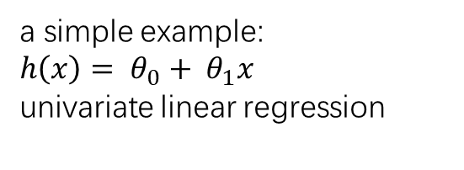
Data (Training Set)
inputs
Function
output
Learning Algorithm
Function
(Hypothesis)
a simple example:
$$h\left(x\right)= θ_{0}+ θ_{1}x$$
univariate linear regression
Notes:
Why this is called hypothesis?
Because it is an estimation, an approximation.

Slide 5


Learning Process
adjust parameters to minimize cost
inputs
Model with initialized parameters
model
output
Cost Function
actual output

Slide 6
inputs
Model with learned parameters
model
output

Slide 7
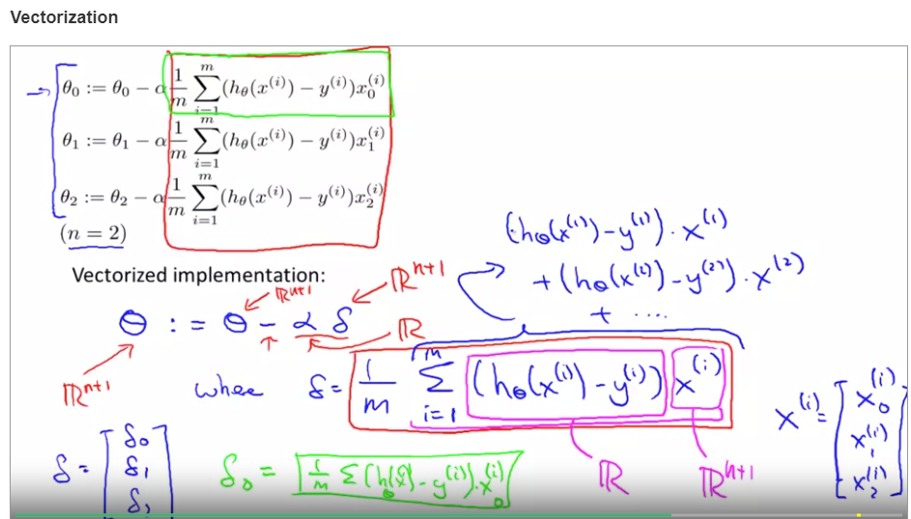
Gradient Descent

Slide 8
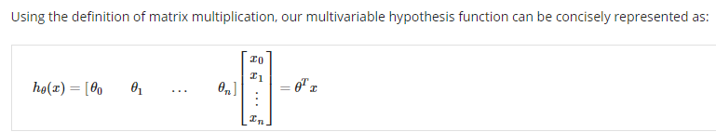
How to define your own ML problems
Give hypothesis function including all input variables and the unknown parameters.
theta is the parameter vector
x is the feature vector

Slide 9

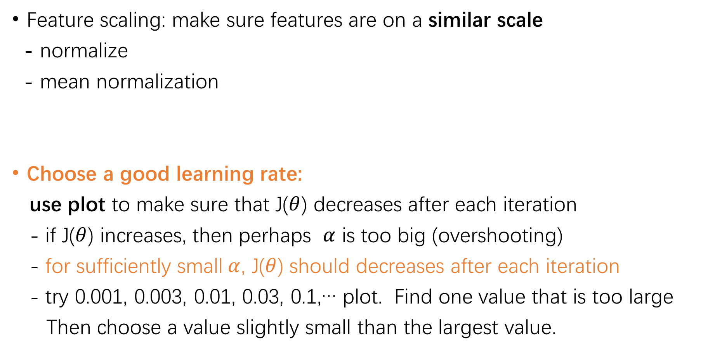
Tricks in Gradient Descent
Feature scaling: make sure features are on a similar scale
- normalize
- mean normalization
Choose a good learning rate:
use plot to make sure that J($θ$) decreases after each iteration
- if J($θ$) increases, then perhaps $α$ is too big (overshooting)
- for sufficiently small$α$, J($θ$) should decreases after each iteration
- try 0.001, 0.003, 0.01, 0.03, 0.1,… plot. Find one value that is too large
Then choose a value slightly small than the largest value.

Slide 10
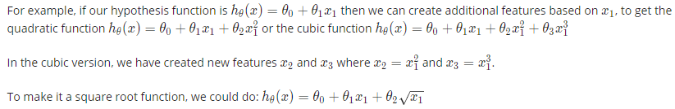
Features & polynomial regression
With domain knowledge, we can use existing inputs to design new features that fit better to the specific problem
when a hypothesis is polynomial function, we can still use the multivariate linear regression model.

Slide 11

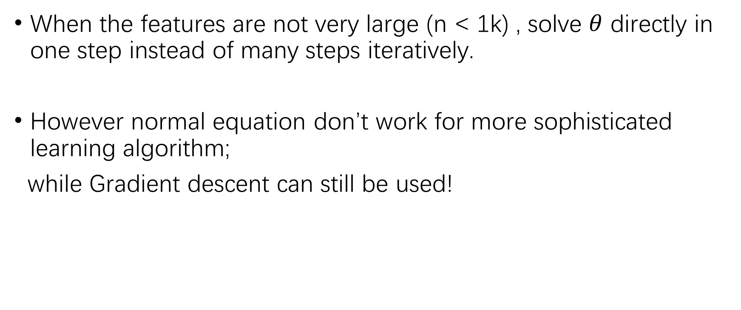
Normal equation for linear regression
When the features are not very large (n < 1k) , solve $θ$ directly in one step instead of many steps iteratively.
However normal equation don’t work for more sophisticated learning algorithm;
while Gradient descent can still be used!

Slide 12
Logistic Regression/Classification

Slide 13
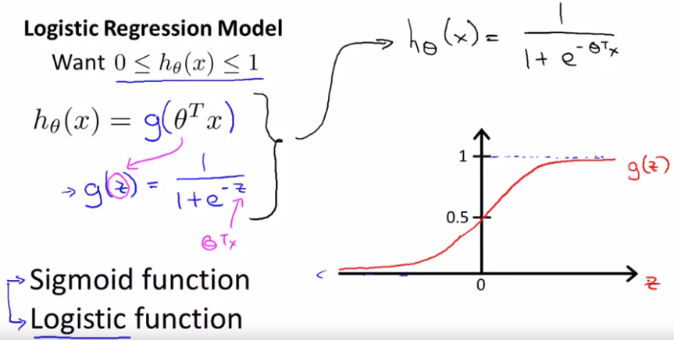


Logistic regression: $0{<h}_{θ}(x)$ < 1
→
$$h\left(θ\right)=P\left(y = 1\right| x; θ)$$
probability that y = 1, given x, parameterized by$θ$

Slide 14
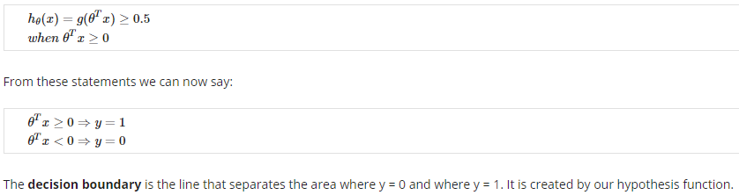
Decision boundary

Slide 15
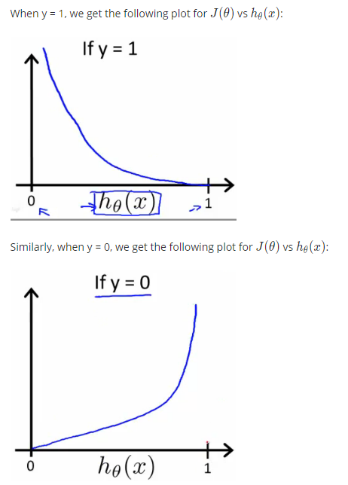


Cost Function

Slide 16
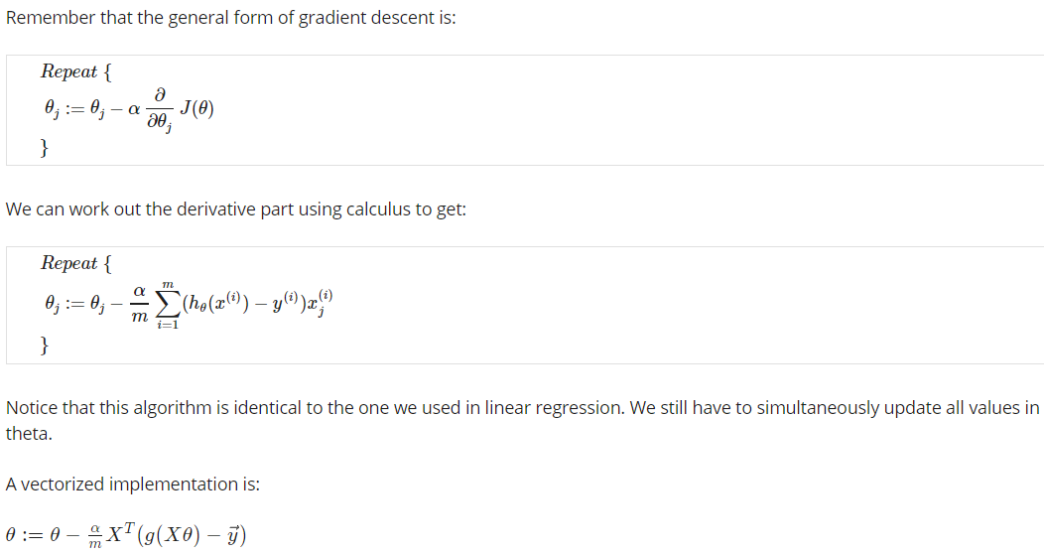
Gradient Descent

Slide 17
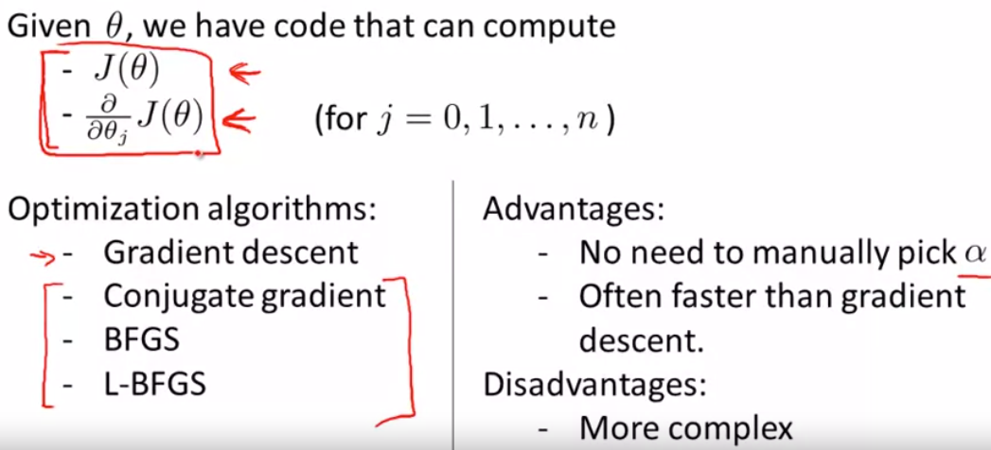
Advanced Optimization
Feed J($θ$) and gradient of J($θ$) into other advanced optimization algorithms, e.g. fminunc

Slide 18
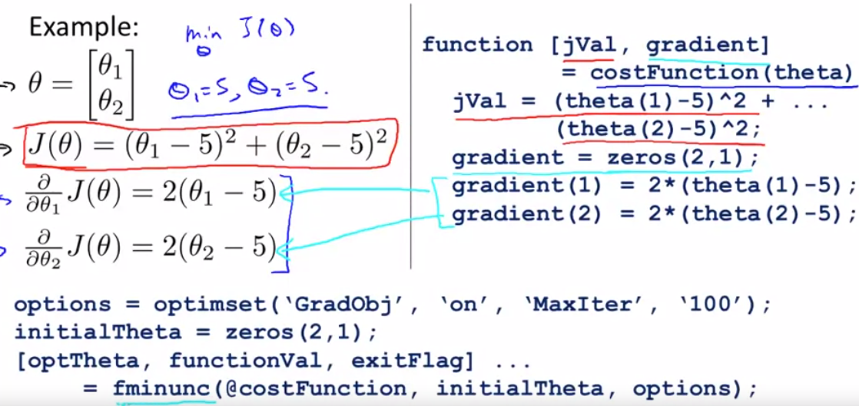

Slide 19
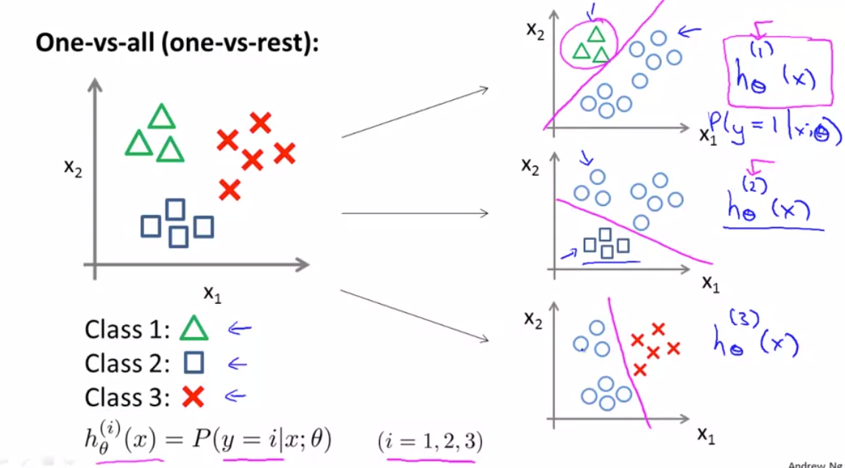
Multiclass classification (one-vs-all)

Slide 20
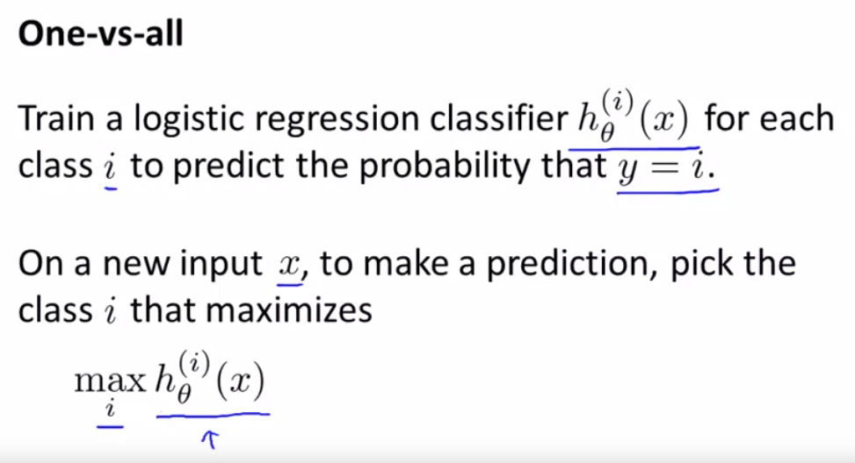

Slide 21
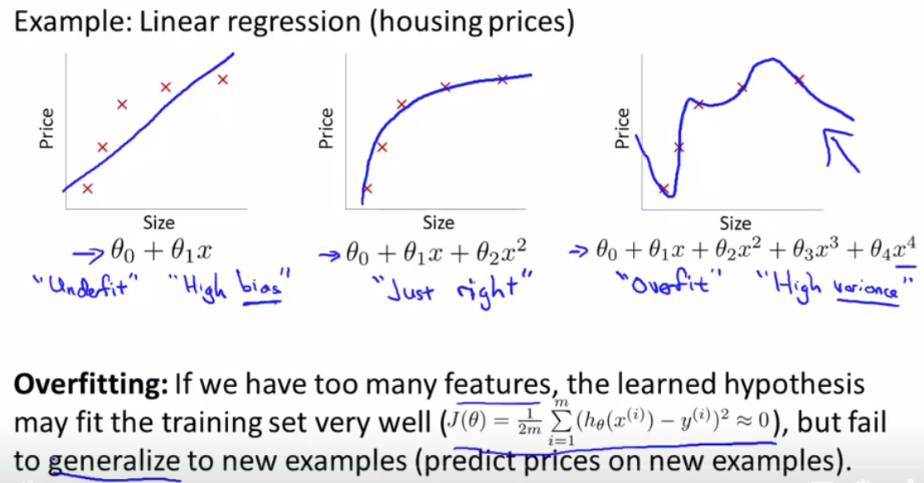
The Problem of Overfitting

Slide 22
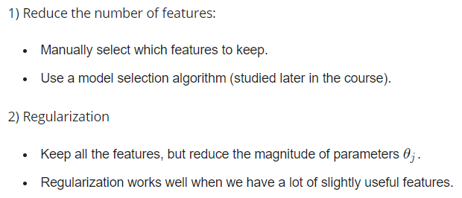

Slide 23
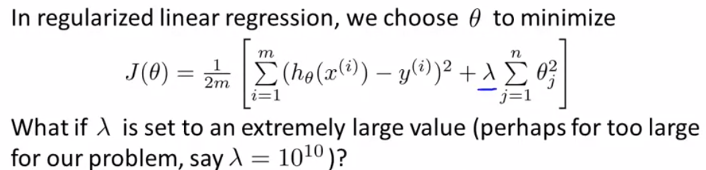
Regularization : Cost Function
shrink parameter θ,
to make the curve smoother and the hypothesis simpler,
→ solve overfitting
However, a too big λ would lead to underfitting

Slide 24
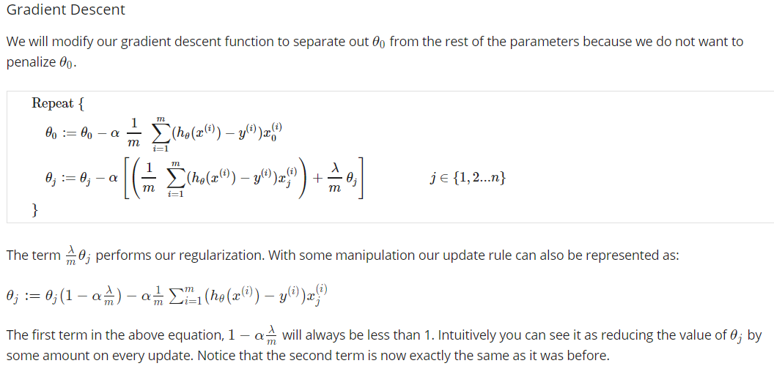
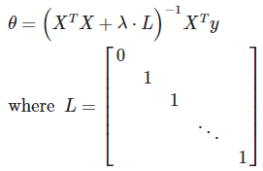
Solve theta directly:

Slide 25
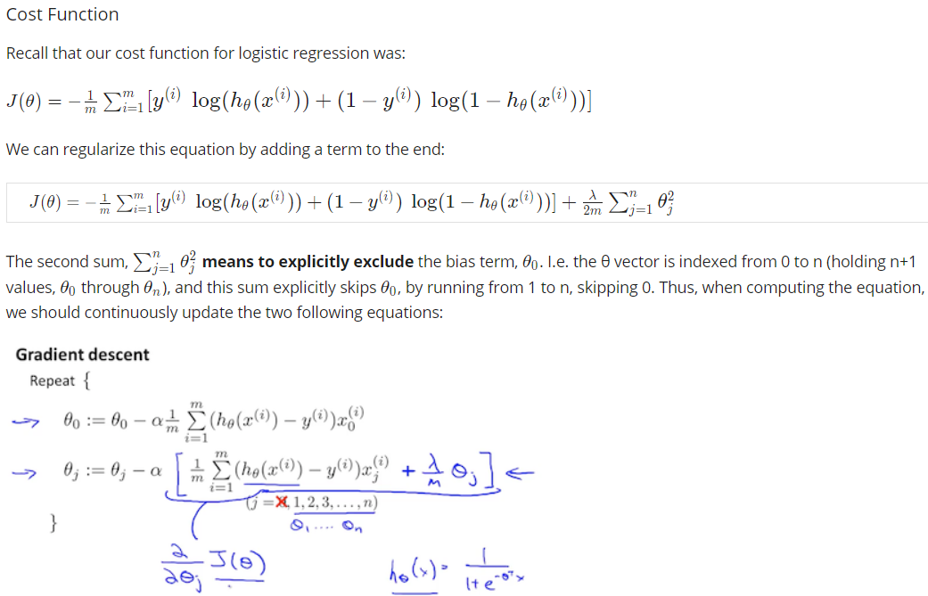
Regularized Logistic Regression

Slide 26
Decision Tree
Learn a hierarchy of if/else questions, leading to a decision

